Slide 1
How to use the ReformCompass for developing sustainability strategies
Prof. Dr. Isabella Proeller
University of Potsdam

Slide 2
Overview
Sustainability Strategies Sustainability Strategies should comprise the various sectoral economic, social and environmental policies and have a longterm perspective.
ReformCompass – The Strategy Instrument The ReformCompass serves equally to develop strategic competence as well as analyze strengths and weaknesses in political reform and organizational change processes.
How to use the ReformCompass for developing a sustainability strategy The ReformCompass can be used to develop sustainability strategies or to analyze strengths and weaknesses of sustainability reform in the public sector.

Slide 3
1) Sustainability Strategies
Sustainability – Definition
"In essence, sustainable development is a process of change in which the exploitation of resources, the direction of investments, the orientation of technological development; and institutional change are all in harmony and enhance both current and future potential to meet human needs and aspirations.“
Report of the World Commission on Environment and Development: Our Common Future (1987)
→ http://www.un-documents.net/our-common-future.pdf

Slide 4
1) Sustainability Strategies
Sustainability Strategies – Defintion
"A national sustainable development strategy is a coordinated, participatory and iterative process of thoughts and actions to achieve economic, environmental and social objectives in a balanced and integrated manner. The process encompasses situation analysis, formulation of policies and action plans, implementation, monitoring and regular review. It is a cyclical and interactive process of planning, participation and action in which the emphasis is on managing progress towards sustainability goals rather than producing a “plan” as an end product.“
UNDESA (UN Department of Economic and Social Affairs). "Guidance in preparing a national sustainable development strategy: managing sustainable development in the new Millenium. Background paper No. 13. DESA/DSD/PC2/BP13". 2002.

Slide 5
1) Sustainability Strategies
Sustainability Strategies – History
1987: World Commission on Environment and Development (Chair: Gro Harlem Brundlandt)
1992: World Summit on Sustainable Development in Rio de Janeiro (→ development of local sustainability strategies)
2002: World Summit on Sustainable Development in Johannesburg (→ development of national sustainability strategies)
2012: World Summit on Sustainable Development in Rio de Janeiro (→ development of green growth strategies)
…

Slide 6
1) Sustainability Strategies
Sustainability Strategies – Principles *
Common vision and strategic objectives
High-level commitment
Horizontal integration
Vertical integration
Participation
Implementation mechanisms and capacity-building
Monitoring, evaluation and strategy renewal
* European Sustainable Development Network (ESDN) → http://www.sd-network.eu/?k=basics of SD strategies

Slide 7
1) Sustainability Strategies
Sustainability Strategies in Germany:
Schleswig- Holstein
Baden-Württemberg (2007, new edition planned for)
Bayern (2002, new edition 2013)
Brandenburg (→ draft version)
Hessen (2008)
Niedersachsen (2008, possibly new edition)
Rheinland-Pfalz (2001)
Sachsen (2013)
Sachsen-Anhalt (→ status report)
Schleswig-Holstein (2003)
Thüringen (2011)
Hamburg
Mecklenburg- Vorpommern
Bremen
Niedersachsen
Berlin
Sachsen- Anhalt
Brandenburg
Nordrhein- Westfalen
Thüringen
Sachsen
Hessen
Rheinland- Pfalz
Saarland
Baden- Württemberg
Bayern
+ many local strategies (since 1992) / + National Strategy (since 2002)

Slide 8
2) ReformCompass – The Strategy Instrument
The ReformCompass: The ReformCompass takes structures and processes into account, systematizes central goals and tasks thus delivering an orientation framework for strategic action.
The dimensions: Three strategic dimensions in particular decide on the success or failure of a reform: competence for appropriate solutions, credible communication (internal and external) as well as the capability to implement solutions.
The phases: The challenge lies in working out these three "C's" equally over the entire process, i.e. from the creation of a strategic group, through to agenda setting, policy formulation and decision-making as well as implementation to (ongoing) impact evaluation.

Slide 9
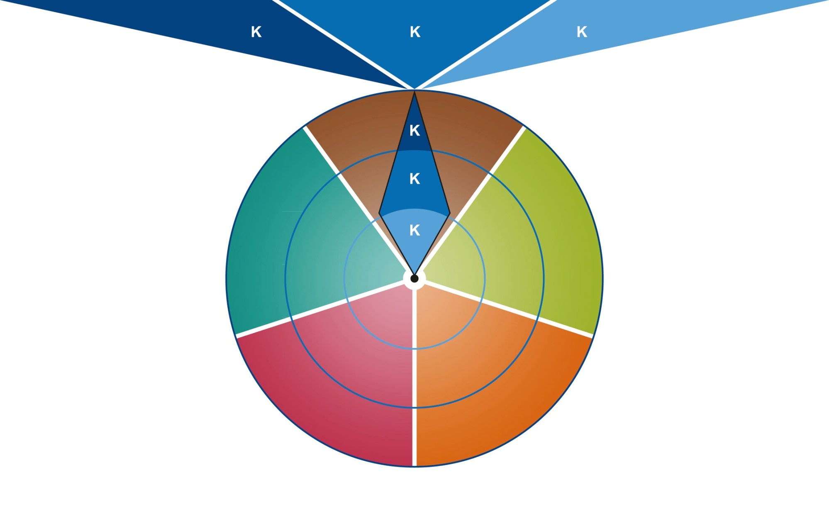
2) ReformCompass – The Strategy Instrument
COMPETENCE
COMMUNICATION
CAPABILITY TO IMPLEMENT
STRATEGY GROUP
PHASE 1
ONGOING IMPACT EVALUATION
PHASE 5
AGENDA SETTING
PHASE 2
IMPLEMENTATION
PHASE 4
FORMULATING AND DECISION-MAKING
PHASE 3

Slide 10
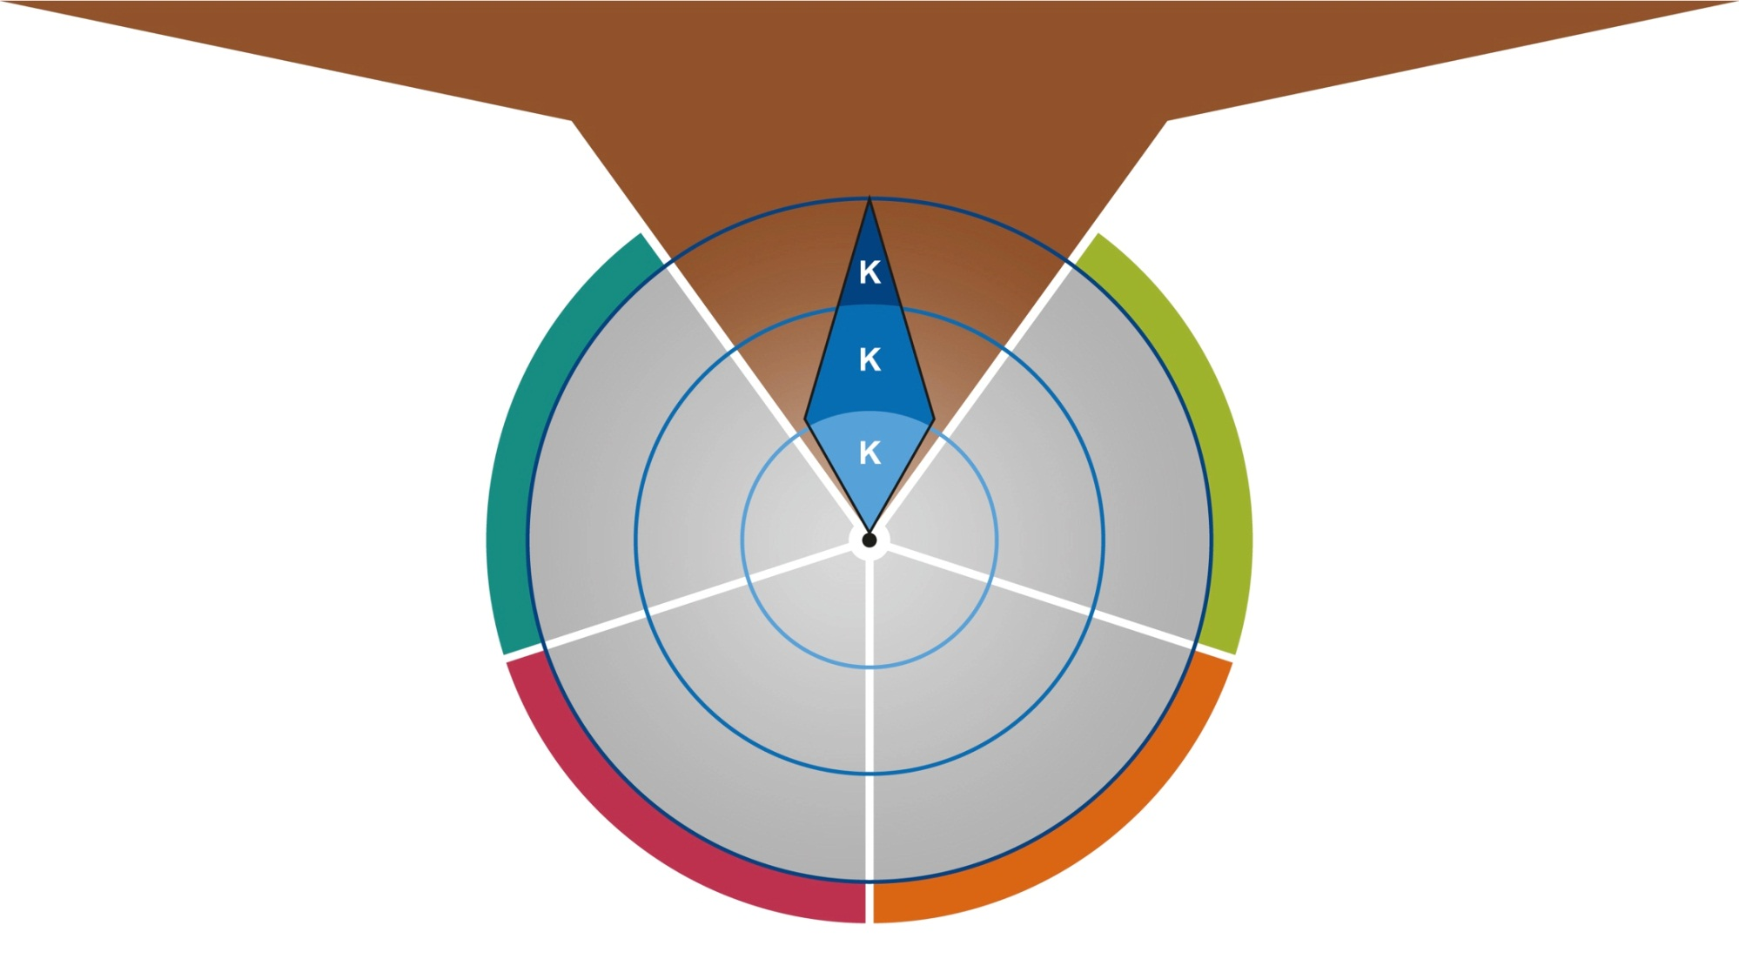
2) ReformCompass – The Strategy Instrument
COMPETENCE
COMMUNICATION
CAPABILITY TO IMPLEMENT
Fostering a culture of innovation
Strengthening communication abilities
Guaranteeing implementation
STRATEGY GROUP
PHASE 1

Slide 11
2) ReformCompass – The Strategy Instrument
COMPETENCE
COMMUNICATION
CAPABILITY TO IMPLEMENT
Fostering a culture of innovation
Strengthening communication abilities
Guaranteeing implementation
GOALS
TASKS
Include internal expertise
Expand access to external knowledge
Develop personnel capacities
What must the composition of the core group be so that the right competencies are represented?
What knowledge is required? Knowledge of the subject matter, administrative knowledge or experience with political processes?
How can know-how internal to the system be included?
What access to external expertise is available? How can this be used and expanded? How quickly can it be obtained?
STRATEGY GROUP
PHASE 1

Slide 12
2) ReformCompass – The Strategy Instrument
COMPETENCE
COMMUNICATION
CAPABILITY TO IMPLEMENT
Fostering a culture of innovation
Strengthening communication abilities
Guaranteeing implementation
GOALS
TASKS
Adjust communication resources and competencies
Coordinate communication
Does the strategic core group have sufficient resources for communication?
Have stable communication channels been set up that ensure the flow of information?
Have the strategic core group and its alliance partners agreed on uniform core messages?
Are the communication instruments in line with each other in terms of content and schedule?
STRATEGY GROUP
PHASE 1

Slide 13
2) ReformCompass – The Strategy Instrument
COMPETENCE
COMMUNICATION
CAPABILITY TO IMPLEMENT
Fostering a culture of innovation
Strengthening communication abilities
Guaranteeing implementation
GOALS
TASKS
Network actors across departments
Develop a conflict early warning system
Which actors strengthen the implementation of the reform and enhance cooperation in the core group?
Which cooperations and networking with other influential committees and bodies are helpful?
How can public opinion be continuously scanned?
How can changes in sentiment of important actors be identified early on?
STRATEGY GROUP
PHASE 1

Slide 14
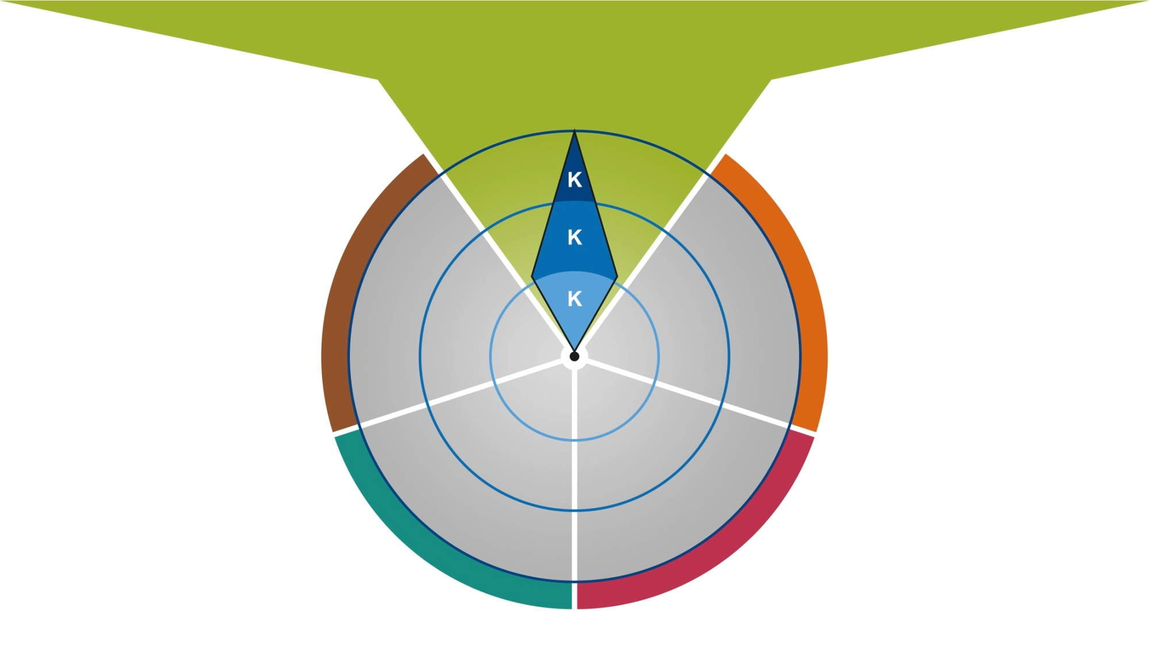
2) ReformCompass – The Strategy Instrument
COMPETENCE
COMMUNICATION
CAPABILITY TO IMPLEMENT
Picking up on future-related issues
Fostering a desire for reform
Calculating the chances of success
AGENDA SETTING
PHASE 2

Slide 15
2) ReformCompass – The Strategy Instrument
COMPETENCE
COMMUNICATION
CAPABILITY TO IMPLEMENT
Picking up on future-related issues
Fostering a desire for reform
Calculating the chances of success
GOALS
TASKS
Identify the need for reform early on
Analyze the specific problem
Clarify the direction of the reform
What is the status of the current academic debate?
Which long-term trends are forecast by academia?
What internal knowledge is already available on the topic?
What are the attitudes to this topic in one's own faction and party?
What are the interests of the population and what are the interests of the lobby groups?
How is the topic discussed in public?
What potential conflicting interests and competing objectives are there?
What risks are and what is the time requirement?
AGENDA SETTING
PHASE 2

Slide 16
2) ReformCompass – The Strategy Instrument
COMPETENCE
COMMUNICATION
CAPABILITY TO IMPLEMENT
Picking up on future-related issues
Fostering a desire for reform
Calculating the chances of success
GOALS
TASKS
Create awareness of the problem
Establish interpretive paradigms
Communicate the central ideas
Is the reform linked to the basic convictions of one's own party?
Has one's own party and the faction been informed and included in the work on the intended reform?
Has the reform issue already been discussed in public or must an awareness of the problems still be created?
Which media players, which multipliers can be won over as implementing actors?
Can the core arguments be supported academically?
What would the costs be if the reform is not implemented?
Does the reform referred to social discussions and overarching values?
Are the positive effects highlighted?
AGENDA SETTING
PHASE 2

Slide 17
2) ReformCompass – The Strategy Instrument
COMPETENCE
COMMUNICATION
CAPABILITY TO IMPLEMENT
Picking up on future-related issues
Fostering a desire for reform
Calculating the chances of success
GOALS
TASKS
Identify windows of opportunity
Determine profiling opportunities
Define negotiation corridors
Does a current development open up a window of opportunity for reform that can be used?
What are others doing? What interests do they pursue? What concepts do they have?
Does a future-related issue bring sufficient profiling potential for the actors and the party?
What options do potential opponents have to torpedo reforms?
How could opponents succeed in mobilizing the public against the reform?
How wide are the negotiation corridors and what are the chances of the reform succeeding?
What are the limits of one's own willingness to compromise?
AGENDA SETTING
PHASE 2

Slide 18
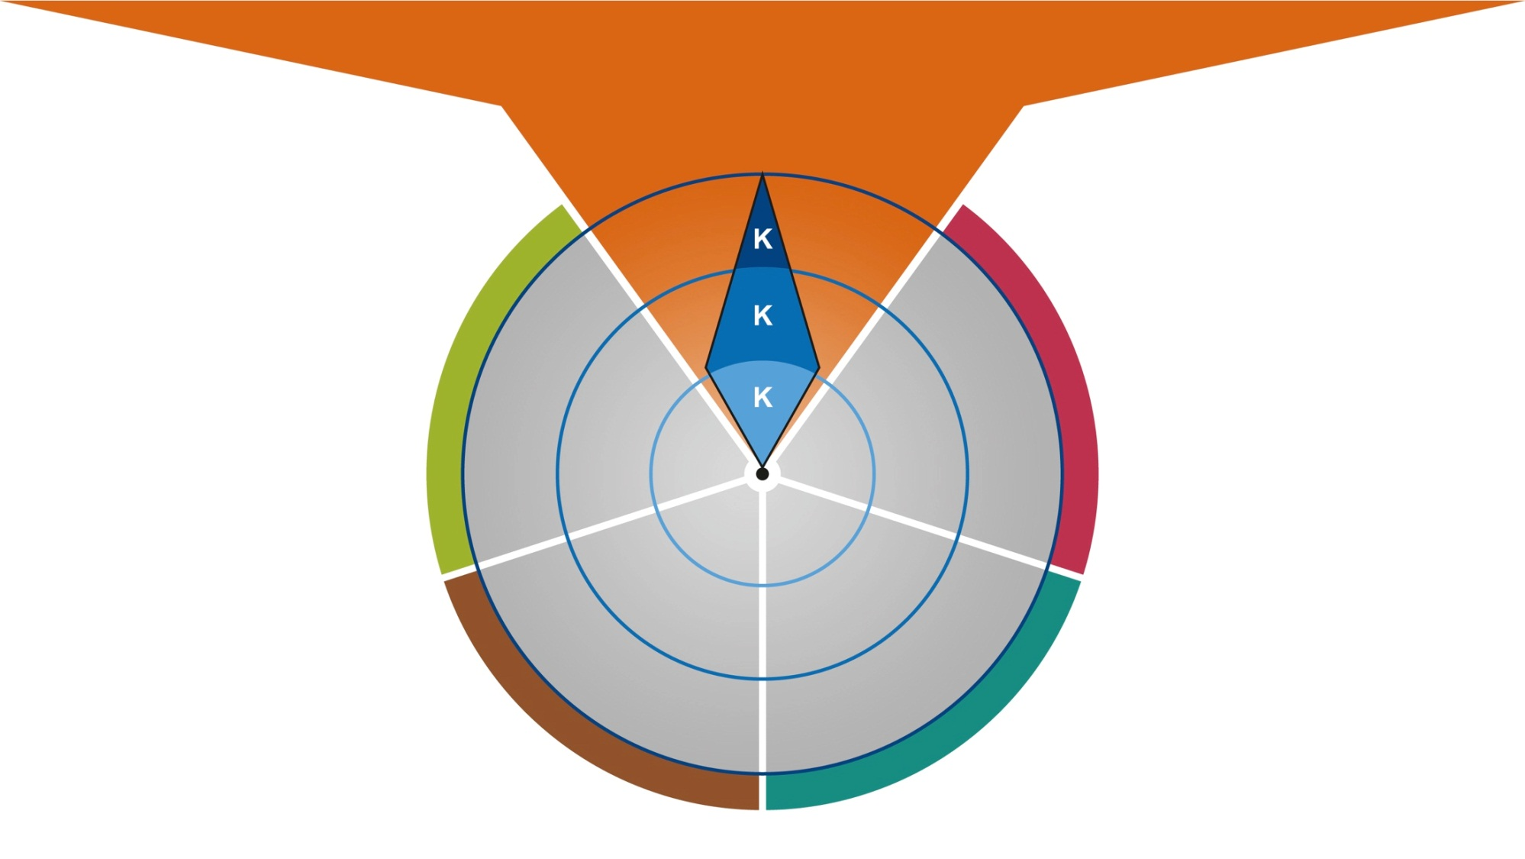
2) ReformCompass – The Strategy Instrument
COMPETENCE
COMMUNICATION
CAPABILITY TO IMPLEMENT
Formulating reform plans
Building trust
Obtaining majority support
FORMULATING AND
DECISION-MAKING
PHASE 3

Slide 19
2) ReformCompass – The Strategy Instrument
COMPETENCE
COMMUNICATION
CAPABILITY TO IMPLEMENT
Formulating reform plans
Building trust
Obtaining majority support
GOALS
TASKS
Sound out options for action
Evaluate alternative solutions
Draft a reform plan
How is the problem solved in other countries?
What do the experts say, what do the implement patient actors say, what are the facts? How do I use this for the reform?
Can effectiveness tests be carried out in the form of pilot projects?
What are the options for action and alternative solutions?
How can the intended reform be divided up into individual steps?
What is the advantage of a "grand reform" and what is the advantage of a reform undertaken in small steps?
Is a time schedule for the intended reform available?
FORMULATING AND
DECISION-MAKING
PHASE 3

Slide 20
2) ReformCompass – The Strategy Instrument
COMPETENCE
COMMUNICATION
CAPABILITY TO IMPLEMENT
Formulating reform plans
Building trust
Obtaining majority support
GOALS
TASKS
Communicate credibility
Use clear and positive reform language
Generate realistic expectations
Establish dialog
What are suitable times for communicating internally and externally?
How do I bring my own party and employees on board?
How are citizens informed? How can dialog be developed and established?
Are the winners and gains emphasized, and positive language used?
Are the reform plans presented and justified as the best workable solution?
Is it clear what is possible, what changes and what doesn't?
Our milestones also communicated in addition to the overall goal?
FORMULATING AND
DECISION-MAKING
PHASE 3

Slide 21
2) ReformCompass – The Strategy Instrument
COMPETENCE
COMMUNICATION
CAPABILITY TO IMPLEMENT
Formulating reform plans
Building trust
Obtaining majority support
GOALS
TASKS
Choose negotiation strategies
Win alliance partners
Ensure public agreement
Can quick successes be realised with the reform?
Have participation procedures been carried out? How do we handle suggestions for improvement and changes?
Can the reform be broken down to individual steps so that quick successes are achievable and that the core of the reform remains intact?
Have the key decision-makers been made offers for cooperation and profiling?
Has it been decided whether negotiations will be carried out conflict– or consensus–orientated?
Can potential reform proponents and the public be mobilized? Can reform opponents be brought around?
Has the participation of those responsible for the implementation of the reform been ensured?
FORMULATING AND
DECISION-MAKING
PHASE 3

Slide 22
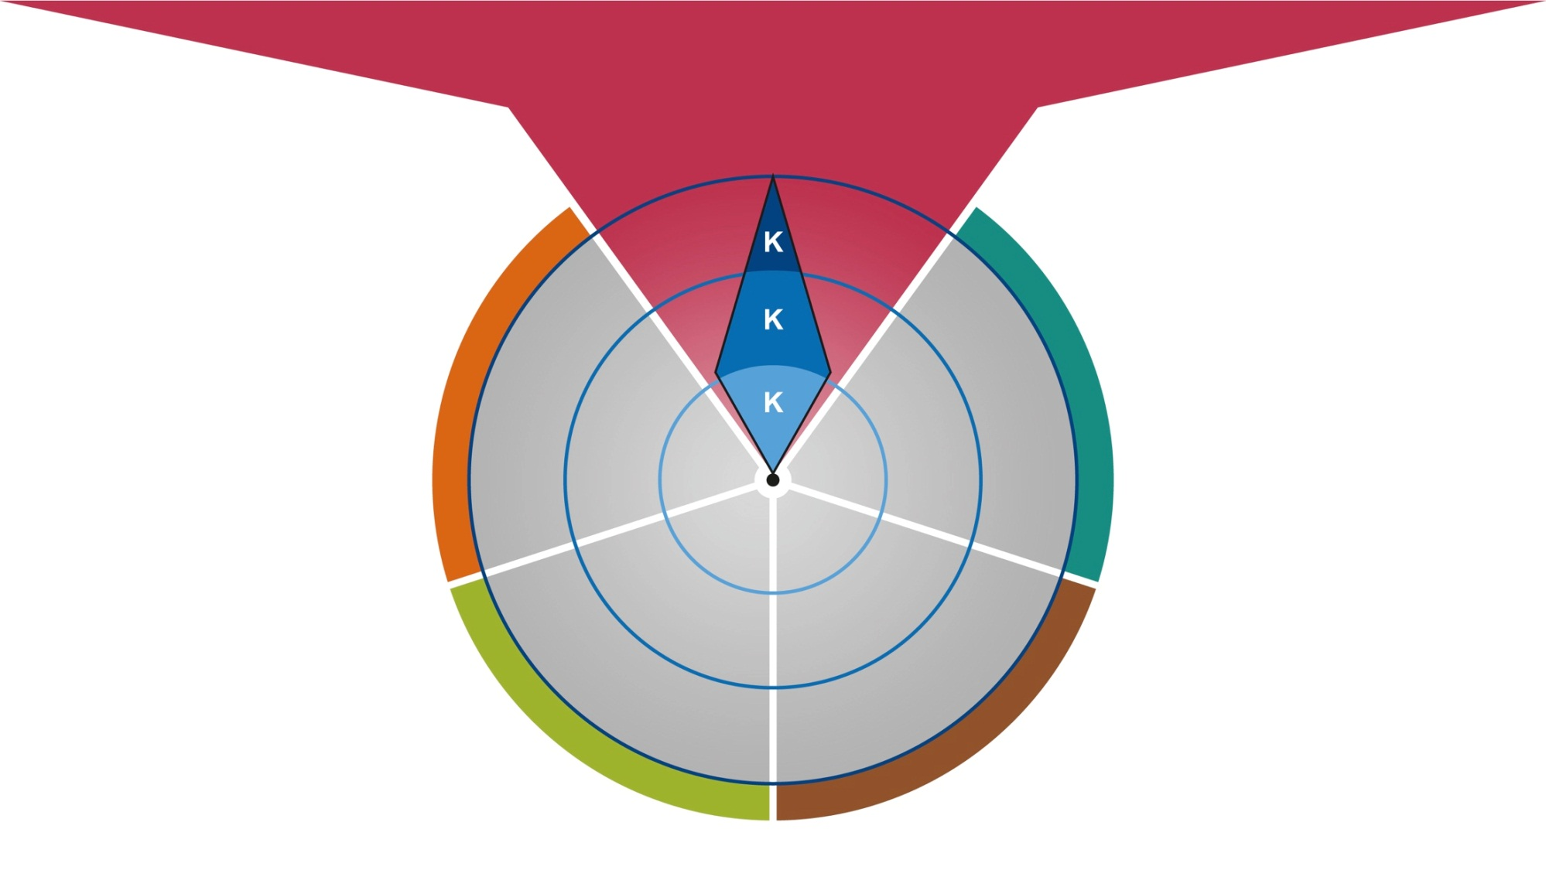
2) ReformCompass – The Strategy Instrument
COMPETENCE
COMMUNICATION
CAPABILITY TO IMPLEMENT
Ensuring quality results
Connecting with citizens
Mobilizing implementation actors
IMPLEMENTATION
PHASE 4

Slide 23
2) ReformCompass – The Strategy Instrument
COMPETENCE
COMMUNICATION
CAPABILITY TO IMPLEMENT
Ensuring quality results
Connecting with citizens
Mobilizing implementation actors
GOALS
TASKS
Ensure effectiveness
Determine implementation steps
Choose suitable management instruments
Has the key goal of the change process been concretely determined?
What do we want to achieve and with which means?
How can the measures and performances be coordinated with the needs of citizens in day-to-day life?
Are the actions of the administration in line with the effects of the reform?
Have detailed time plans, budgets and decision-making rules been prepared?
Have management instruments, information measures, precepts and prohibitions as well as financial incentives been selected?
IMPLEMENTATION
PHASE 4

Slide 24
2) ReformCompass – The Strategy Instrument
COMPETENCE
COMMUNICATION
CAPABILITY TO IMPLEMENT
Ensuring quality results
Connecting with citizens
Mobilizing implementation actors
GOALS
TASKS
Ensure communication between citizens, the administration and politics
Ensure that processes are transparent
How appropriate are the people who implement the reforms in terms of technical expertise and communication?
Are citizens communicated with in simple and easy to understand language?
Has continuous dialog with implementation actors been ensured?
Are problems in implementation, suggestions and criticism openly discussed with those responsible for implementation?
Are suggestions for improvement actively obtained and implemented early on?
Are successes communicated to the public? Problems in the implementation mentioned openly and solutions presented?
IMPLEMENTATION
PHASE 4

Slide 25
2) ReformCompass – The Strategy Instrument
COMPETENCE
COMMUNICATION
CAPABILITY TO IMPLEMENT
Ensuring quality results
Connecting with citizens
Mobilizing implementation actors
GOALS
TASKS
Clarify interactions with relevant actors
Include the administration
Create clear responsibilities
Do we talk to all the important actors regularly?
Are the expertise and needs of relevant stakeholders taken into account?
Is administrative know-how called for?
Does the administration have leeways for their decision-making?
Are responsible persons nominated and competencies clearly regulated?
Have schedules, budgets and content been determined with binding effect?
IMPLEMENTATION
PHASE 4

Slide 26
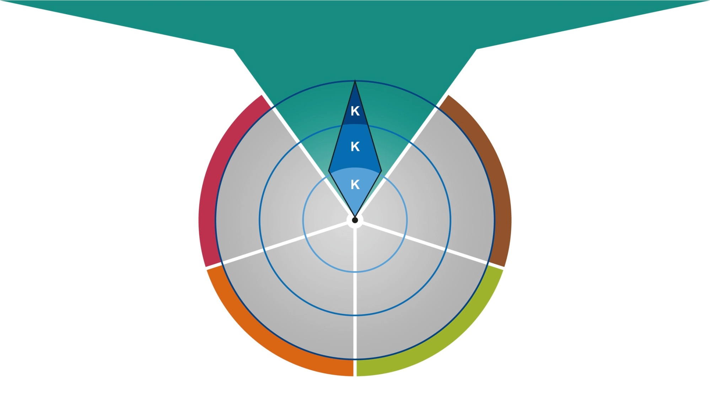
2) ReformCompass – The Strategy Instrument
COMPETENCE
COMMUNICATION
CAPABILITY TO IMPLEMENT
Improving monitoring tools
Guaranteeing responsiveness
Keeping options open
ONGOING
IMPACT EVALUATION
PHASE 5

Slide 27
2) ReformCompass – The Strategy Instrument
COMPETENCE
COMMUNICATION
CAPABILITY TO IMPLEMENT
Improving monitoring tools
Guaranteeing responsiveness
Keeping options open
GOALS
TASKS
Choose suitable evaluation methods
Evaluate these methods as part of the process
Evaluate the cost and benefit
Are the goals so clearly formulated that they can be reviewed and results and effects be measured?
How do we evaluate the reform? Do we already have good instruments or do we need to develop new ones?
Has a systematic exchange between the implementation actors been established?
Are the level of target achievement, performances, costs and efficiency as well as processes evaluated?
Are the effects continuously reviewed and adjustments made if needed?
Do the management instruments fulfill their purpose and are they accepted?
ONGOING
IMPACT EVALUATION
PHASE 5

Slide 28
2) ReformCompass – The Strategy Instrument
COMPETENCE
COMMUNICATION
CAPABILITY TO IMPLEMENT
Improving monitoring tools
Guaranteeing responsiveness
Keeping options open
GOALS
TASKS
Analyze public resonance
Maintain dialog with relevant actors
Pass on reform results according to the target group
Are the opinions of participants and affected parties actively obtained and analyzed?
Have public opinion and media reports been actively obtained and analyzed?
Have assessments from party members been obtained?
Do we know what the population thinks about the reform? How do implementation actors and stakeholders assess the reform?
Are successes disseminated specific to the target group?
Are negative results communicated together with suggestions for improvement?
ONGOING
IMPACT EVALUATION
PHASE 5

Slide 29
2) ReformCompass – The Strategy Instrument
COMPETENCE
COMMUNICATION
CAPABILITY TO IMPLEMENT
Improving monitoring tools
Guaranteeing responsiveness
Keeping options open
GOALS
TASKS
Make adjustments flexibly
Take into account changed configurations of actors
Are review dates determined in advance?
Which criteria and decision-making rules should apply to the reform change?
Are potential conflicts between the relevant actors continuously sounded out
Does the composition of the strategic core group need to be adjusted?
Do we need other, new people in the team or new people as proponents?
Is it necessary to adjust the implementation strategy?
ONGOING
IMPACT EVALUATION
PHASE 5

Slide 30
3) How to use the ReformCompass for developing a sustainability strategy
Sustainability Strategy | Competence | Communication | Capability to implement
Strategy Group | Knowledge of social, economic and ecological sustainability required Knowledge of different sectoral policies required Knowledge of performance management required Knowledge of participation methods required | Transparency, participation and accountability as guiding principles Establishing communication channels to internal stakeholders (departments) and external stakeholders (media, business, civil society) Guaranteeing coherence with sectoral communication | Locating the strategy group at the government headquarters Installation of interdepartemental groups on strategic and operational level Installation of external Advisory Board with representatives of different stakeholders

Slide 31
3) How to use the ReformCompass for developing a sustainability strategy
Sustainability Strategy | Competence | Communication | Capability to implement
Agenda Setting | Distinguishing the longterm challenges in different policy fields (e. g. financial crises, climate change, …) Distinquishing the conflicting attitudes of different lobby groups (business, civil society) Describing the current political framework (e. g. government program, coalition treaty, …) | Knotting the topic of sustainability to longterm policy outlines (e. g. budget consolidation, CO₂ reduction, …) Highlighting national and international best practices (e. g. Buthan, Costa Rica, …) Pointing to scientific evidence (e. g. UN, OECD, …) | Identifying „windows of opportunities“ (e.g. Rio+20 Conference, new election, …) Identifying potential opponents (e.g. entrepreneurs, business organisations, …)

Slide 32
3) How to use the ReformCompass for developing a sustainability strategy
Sustainability Strategy | Competence | Communication | Capability to implement
Formulating and Decision Making | Developing different solutions / options Developing coherent targets, indicators and measures for all relevant policy fields Developing action plans (short, medium and longterm) Execution of prospective sustainability assessments | Informing internal and external stakeholders as well as the general public at a very early stage Application of suitable participation methods (e. g. online consultation, public hearing, …) Giving account of how the results of the participation process have been used | Win alliance partners such as civil society organisations Start with formulating strategies in „uncritical“ policy areas

Slide 33
3) How to use the ReformCompass for developing a sustainability strategy
Sustainability Strategy | Competence | Communication | Capability to implement
Implementation | Establishing start projects (e. g. sustainable budgeting, sustainable procurement, …) Establishing controlling routines (e. g. sustainability reports, reviews, …) | Ensure ongoing communication with internal and external stakeholders (e. g. via start projects) Ensure ongoing communication about successes (e. g. via newsletters, yearly sustainability conferences, …) | Continuation of structures for the development of the strategy (e. g. working groups, advisory boards, …)

Slide 34
3) How to use the ReformCompass for developing a sustainability strategy
Sustainability Strategy | Competence | Communication | Capability to implement
Ongoing Impact Evaluation | Establishing perfomance management routines (e. g. by using sustainability indictors) Establishing regular up-dating procedures (e. g. by carrying out peer reviews) | Analyzing the different opinions (e. g. by stakeholders, politicians, …) Communicating the results of the impact evaluation (target group specific) | Review the composition of the strategy group Review the composition of internal and external participants

Slide 35
Thank you very much
Prof. Dr. Isabella Proeller
Universität Potsdam
Lehrstuhl für Public und
Nonprofit Management
August-Bebel-Straße 89
14482 Potsdam

