Slide 1
Managing Strategic and Organizational Change as a Top-Down Process
Hertie School of Governance
Elective – Sessions 6/7
Dr. Jörg Dräger
March 23rd, 2012

Slide 2
Bertelsmann Foundation
Guidelines for Strategic Policy Reform
(Christina Tillmann)

Slide 3
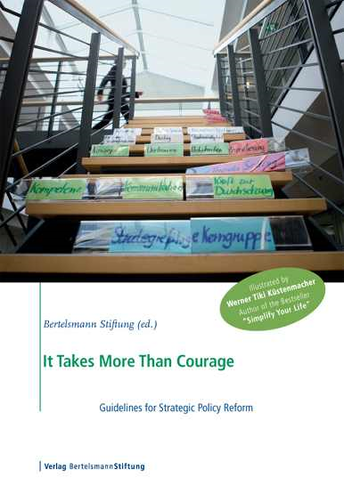
The Guidelines for Strategic Policy Reform offer a practice-oriented framework for planning and analyzing reform processes
…help setting priorities
…provide orientation
…widen the options of action
…develop a long-term strategy
What is this
framework
good for?
…help optimizing the structure of a reform process
…help
planning goal-oriented reforms

Slide 4
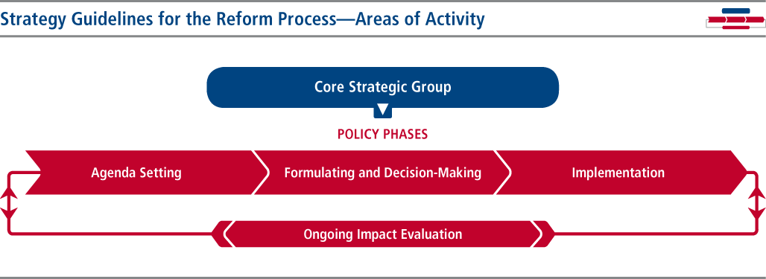
The Guidelines for Strategic Policy Reform follow the structure of
an adapted policy cycle – 1st structuring criterion
Problem definition
Agenda setting
Adaptations:
Core Strategic Group as an separate area of activity
ongoing impact evaluation
Environment/
Media
Evalu-
ation
Decision
Implemen-tation of policy

Slide 5
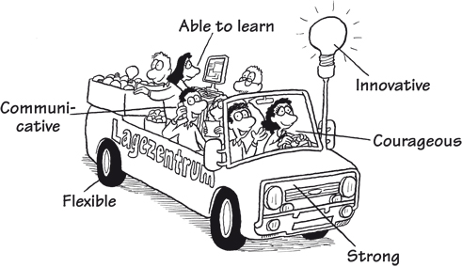
The Core Strategic Group: Indispensable “strategy unit” and
crucial to every reform’s success
Composition differs depending on the policy area
Engine and steering wheel
behind the reform
Core Strategic Group with
„three C-qualifications“
  Fostering a culture of innovation
  Strengthening communication
  abilities
  Guaranteeing implementation capabilities

Slide 6
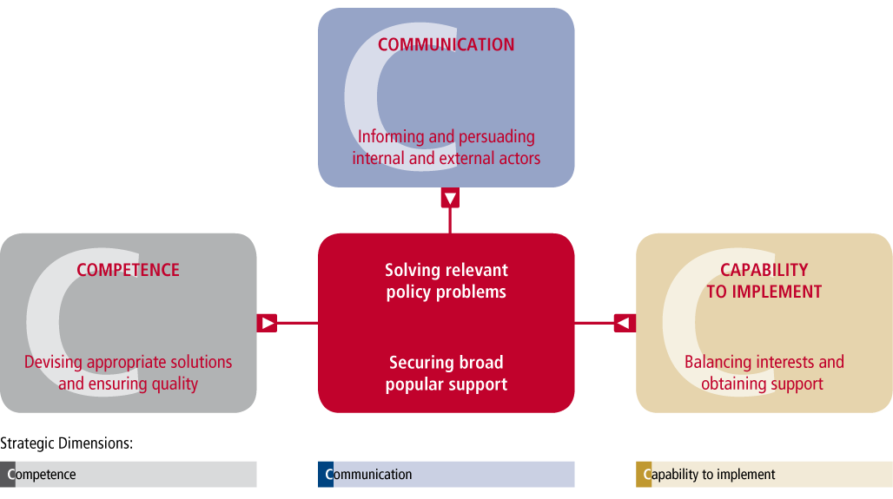
The Guidelines for Strategic Policy Reform are based on three strategic dimensions (“The Three C’s”) - 2nd structuring criterion
Competence, Communication, and Capability to Implement as main determining factors whether a reform fails or succeeds
Balance between these dimensions is favourable for reform success, but context-specific weighting by decision-makers

Slide 7
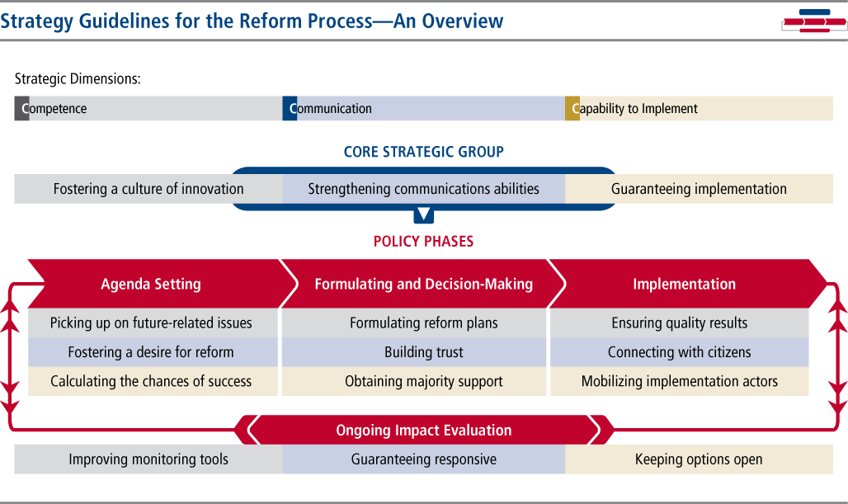
Synthesis: The Bertelsmann Foundation Guidelines for Strategic Policy Reform at a Glance

Slide 8

Synthesis: The Bertelsmann Foundation Guidelines for Strategic Policy Reform – again applied to the Hamburg University Reform
Competence
Communication
Capability
Successful core strategic group until decision-making
Intensive and successful
communication before implementation
Agenda setting: raising awareness
and picking-up future-related issues
as a solid basis for change
Formulating and decision-making: careful reform plan and majority support
Reduced core strategic group during implementation
Controversial and juxtaposing communication during implementation
Implementation: connecting and mobilizing actors within universities rarely succeeded
Ongoing impact evaluation: did not take place

Slide 9
From ex-post to ex-ante use of the Guidelines – Example 1
Who?
What?
German Ministry – core strategic group of eight individuals (State Secretary, Division Head, Division Unit)
Two ongoing reform processes in different phases of the cycle
Bertelsmann
Stiftung as a
moderator
  Instrument for status quo analysis: Which dimension
  has been neglected? What has gone wrong? Which positions of stakeholders have to be reevaluated?
  Strategic planning of the next steps: Which strategic dimension should be at the center of actions to make these reforms successful? How can past mistakes be „cured“?
How?

Slide 10
From ex-post to ex-ante use of the Guidelines – Example 2
Who?
What?
Local chapter of a German nationwide NPO –
core strategic group of five persons + external moderator
Developments of aims and strategic goals for the medium to long-term future
Guidelines
- standalone -
  Instrument for status quo analysis
  Strategic planning for the next 10 years
  Adjustments to the organisational structure in order
  to reach the goals more efficiently and effectively
  Instrument to improve performance management
How?

Slide 11
The Guidelines for Strategic Policy Reform –
Learnings and success factors for their use in practice
Commitment of leaders to using the Guidelines is indispensable
Pragmatic and selective approach to using the Guidelines maximizes results
External moderator is helpful
for staying on track
Link to organisational change processes increases sustainability of results

Slide 12
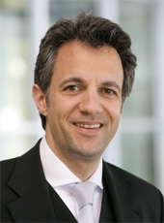

Referent
Vorstand
Any questions or comments? – Please do not hesitate to contact us
Dr. Jörg Dräger
Member of the Executive Board
of the Bertelsmann Stiftung
Managing Director
of the Center for Higher Education Development
(Centrum für Hochschulentwicklung, CHE)
Mail: joerg.draeger@bertelsmann-stiftung.de
Chistina Tillmann
Project Manager
Programm Future of Democracy
Mail: christina.tillmann@bertelsmann-stiftung.de
Phone: 05241 81 81456
Thank you for your attention!

